Slide 1
Image Filtering
Moving Average Filter
The moving average filter is a very simple lowpass filter that is very common in noise reduction applications. It simply replaces each pixel’s value with the average value of all the pixels in a neighborhood.
It is very effective in removing Gaussian noise.
For this exercise you are tasked to perform moving average filtering on an image that has been corrupted with noise.

Slide 2
Image Filtering
Moving Average Filter
The algorithm takes as input a noise image and the size of the moving average filter window and applies moving average filtering to the image by changing the value of each pixel with the average value of al the pixels in the current window. Then it returns the filtered image. It uses 0-padding in order to avoid the creation of black borders in the image.
Finally, the filtered image is displayed alongside the noise one.

Slide 3

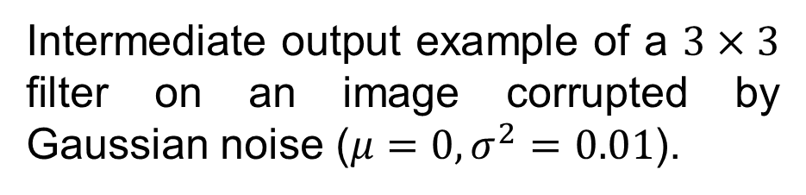
Image Filtering
Moving Average Filter
Input example.
Intermediate output example of a $3×3$ filter on an image corrupted by Gaussian noise ($μ=0, σ^{2}=0.01$).

Slide 4
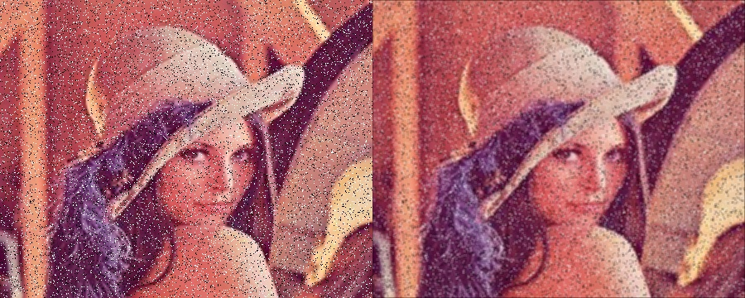

Image Filtering
Moving Average Filter
Output example of a $3×3$ filter on an image corrupted by salt and pepper noise.

